Slide 1
OWASP SAMM v1.5
Building Towards a More Secure Applications World …

Slide 2
Project History
OpenSAMM 1.0
SAMM 1.1
SAMM 1.5
OpenSAMM

Slide 3
Sneak Preview: What’s new in v1.5 ?
Scoring system
Toolbox
Updated documents and slidedeck

Slide 4
Agenda
Software Assurance?
OWASP SAMM
Quick start
Resources & Toolbox
Get involved
Notes:
SEBA
fixme:
how much time do we have? 50 totaal.
how much time to spend per topic?
who does which slides?

Slide 5
“Build in” software assurance
proactive
reactive
security
requirements /
threat modeling
coding guidelines code reviews static test tools
security testing dynamic test
tools
vulnerability
scanning -
WAF
Design
Build
Test
Production
Secure Development Lifecycle
(SAMM)
● 5 
Notes:
SEBA
go to the “left”

Slide 6

Why using a Maturity Model
An organization’s behavior changes slowly over time
Changes must be iterative while working toward long-term goals
There is no single recipe that works for all organizations
A solution must enable risk-based choices tailored to the organization
Guidance related to security activities must be prescriptive
A solution must provide enough details for non-security-people
Overall, must be simple, well-defined, and measurable
OWASP Software Assurance Maturity Model (SAMM)
Notes:
SEBA

Slide 7
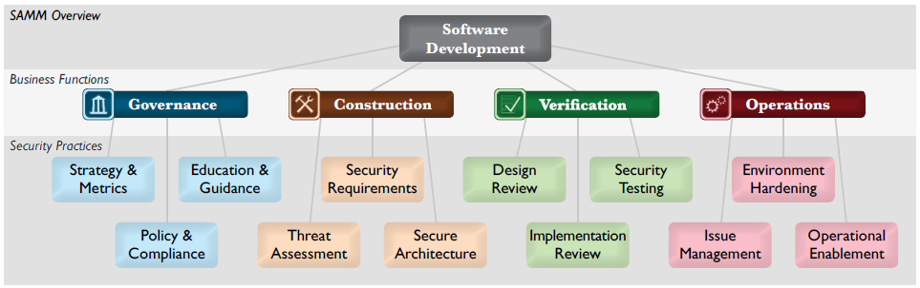
SAMM Security Practices
For each of the Business Functions, 3 Security Practices are defined
The Security Practices cover areas relevant to software security assurance
Each one is a ‘silo’ for improvement
Notes:
BART
OpenSAMM is defined in different levels.
At the highest levels, divided in four tasks or concerns to take into account while developing or using software.
They align well with a typical organisational structure, and this is how software security typically ties into an organisation.
Remark not only about development …
At a lower level, a number of security practices are defined that should be considered for improving software security.
This is where the organisation and software assurance are linked together.
At the lowest level, every security practice consists of a set of activities, ordered in maturity levels.

Slide 8
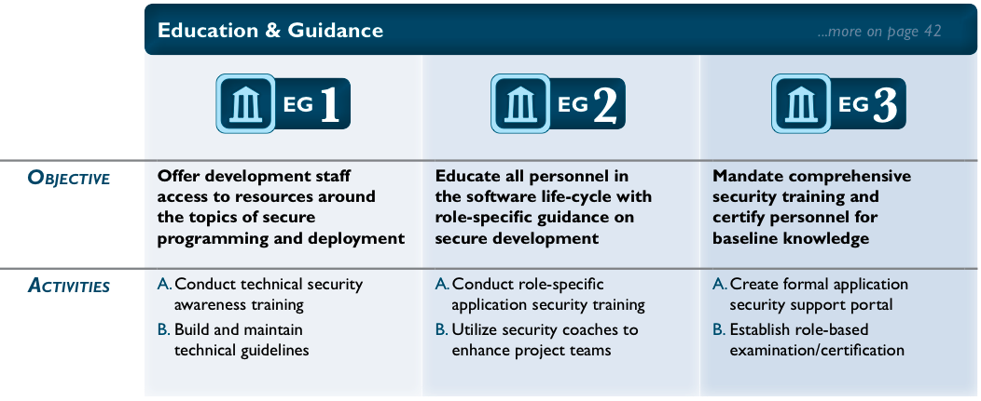
Example: Education & Guidance
Notes:
BART
Briefly explain levels and activities
Link to People - Process - Knowledge - Tools

Slide 9
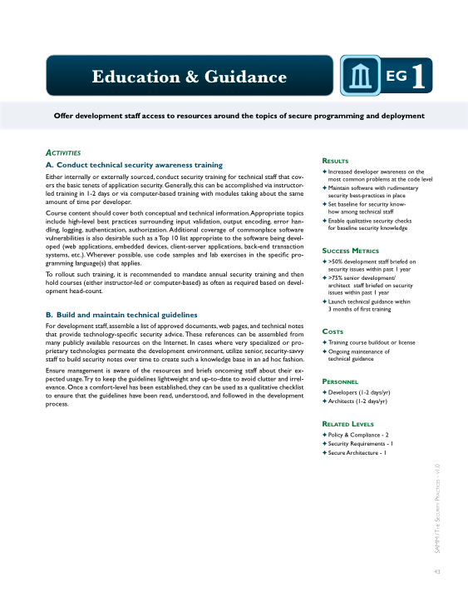
Per Level, SAMM defines...
Objective
Activities
Results
Success Metrics
Costs
Personnel
Related Levels
Notes:
BART
This information is important for applying OpenSAMM into organisations, as you will see later during this presentation.

Slide 10
On Maturity levels & Assessment scores
No
Few/Some
At Least Half
Many/Most
0
Practice being unfulfilled
Ad-hoc provision
Increased efficiency/effectiveness
Comprehensive mastery at scale
1
2
Transparent view over different levels
Fine-grained improvements are visible
3

Slide 11
SAMM Quick Start
ASSESS questionnaire
GOAL gap analysis
PLAN roadmap
IMPLEMENT
OWASP resources
Continuous Improvement
Iterative
Small Steps
Notes:
SEBA
Use 4 step improvement iterations:
Measure levels => assessment QA
Set goals => gap analysis
Plan => Roadmap
Implement => with other OWASP material
And go back to 1)

Slide 12
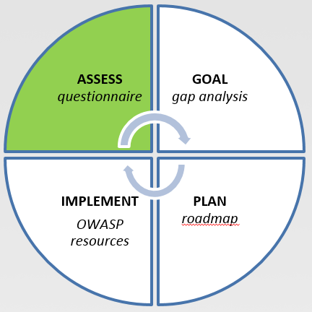
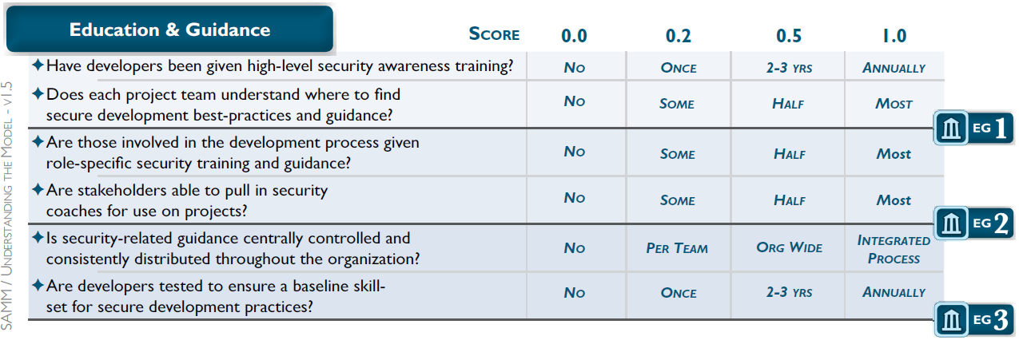
Assess
Assessment worksheets for each Security Practice
Notes:
SEBA

Slide 13
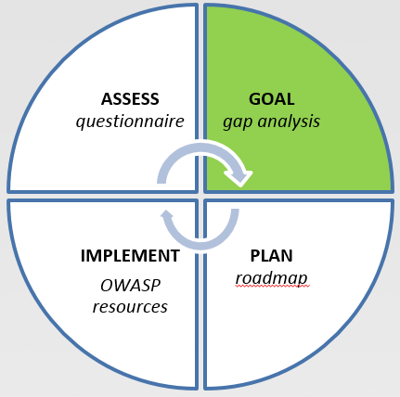
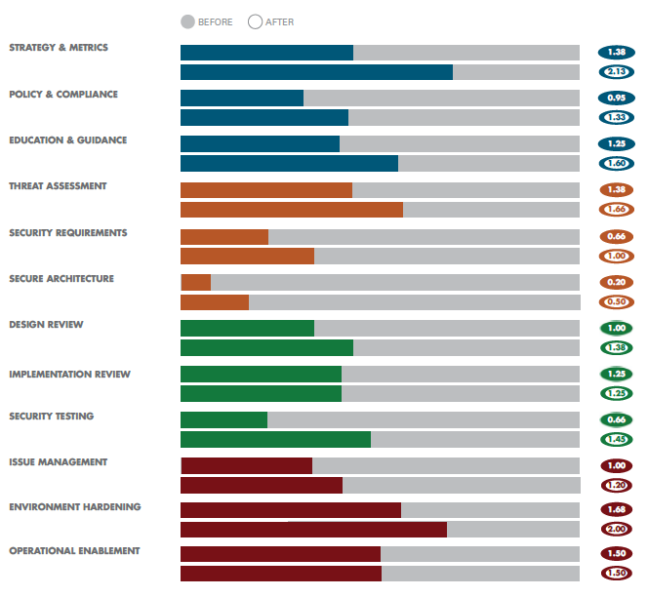
Goal
Gap analysis
Demonstrating improvement
Ongoing measurement
Notes:
BART
Important step in software assurance program. Here you want to move from ad-hoc efforts to a more structured approach.
OpenSAMM gives you a structured foundation to reason about this.
Long-term (3 to 5 years) vs. per iteration
Scorecard
Scorecards can be used at distinct phases in a software assurance program.

Slide 14
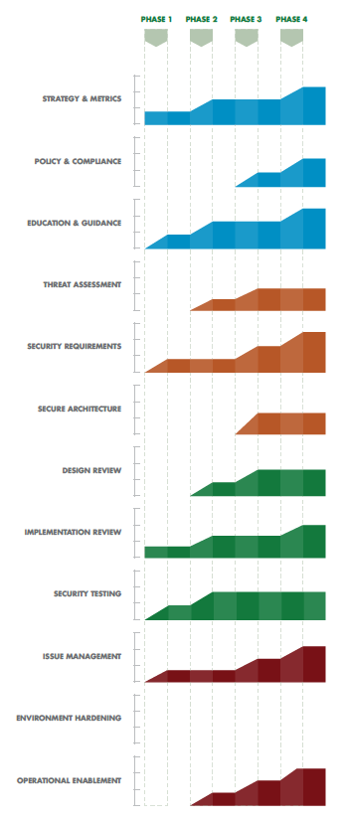
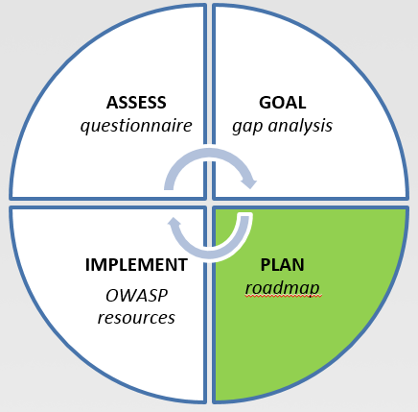
Plan
Roadmaps: use the “building blocks”
Templates for typical kinds of organizations
Tune these to your own targets / speed
Notes:
BART
The way in which you’re going to reach the goals that you’ve set earlier, by planning concrete improvement steps into a roadmap.
Length of phases is 3 to 6 months, sometimes up to a year.

Slide 15
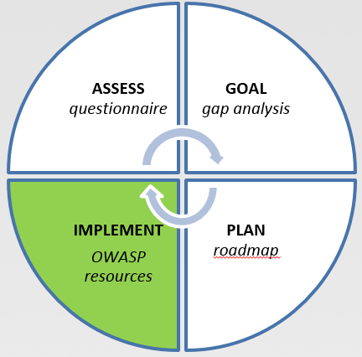
Implement: 150+ OWASP resources
WebGoat
iGoat, GoatDroid
AppSec Tutorials
Top Ten
Education
Testing Guide
Hackademic Challenges
Red Book
Development Guide
Cheat Sheets
Quick Reference Guide
Notes:
SEBA

Slide 16
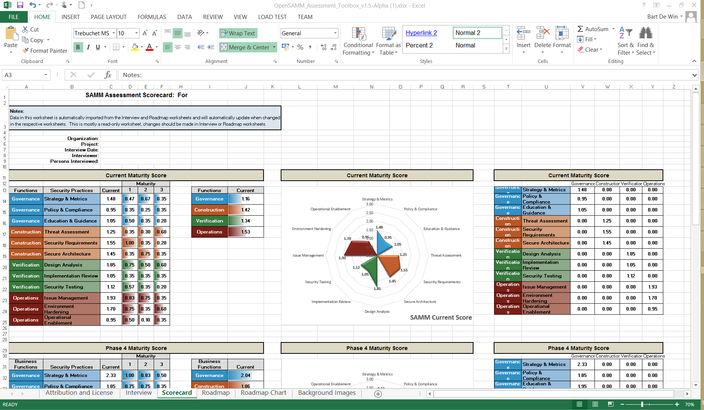
SAMM Toolbox

Slide 17
Project Roadmap
V2.0 (In Progress):
Model revision ?
Application to agile
Roadmap effort planning
…
Build the community:
Grow list of SAMM adopters
Workshops at conferences
Dedicated SAMM summit
…
Notes:
SEBA

Slide 18

Get involved
Project mailing list / work packages
Use and donate (feed)back!
Donate resources
Sponsor SAMM
Notes:
BART

Slide 19

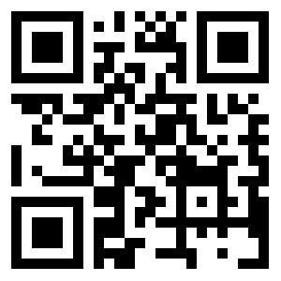
Follow OWASP SAMM
twitter.com/OwaspSAMM
Notes:
BART

Slide 20
Thank you!

